Slide 1


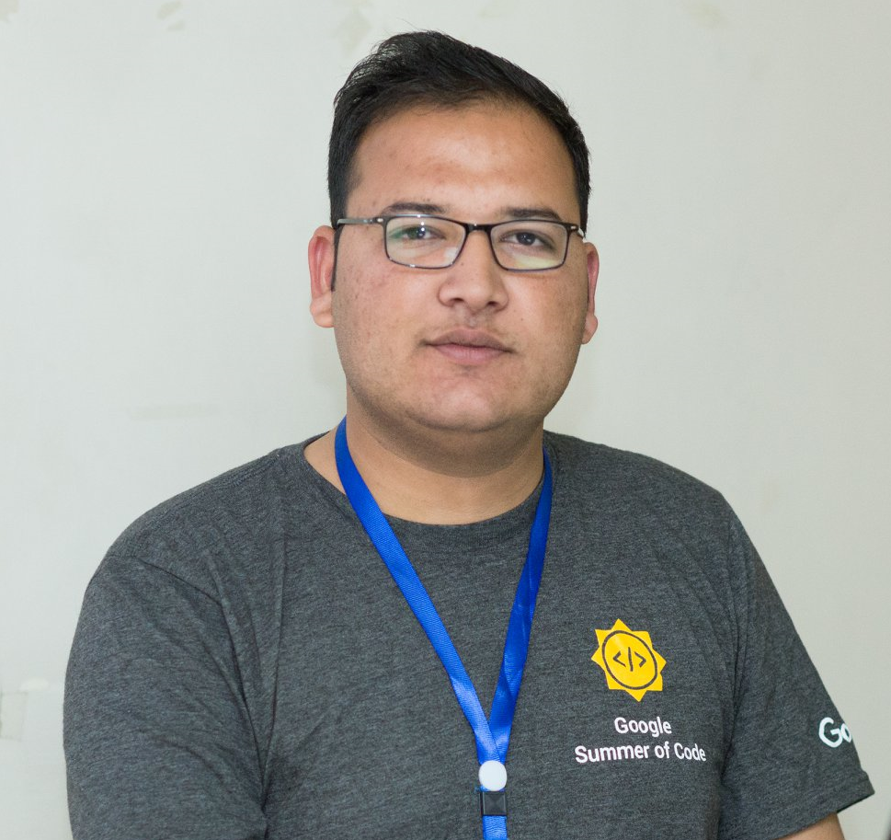
Google Summer of Code
Information Session
Noor Binte Amir
GSoC Scholar 2019 WTM Scholar 2019
Tahir Ramzan
GSoC Scholar 2015 and 2016
GCI Mentor 2018 and 2019

Slide 2
About Me
Noor Binte Amir
Final Year Student at NUST H-12 Google Summer of Code Intern 2019 Google Women Techmakers Scholar 2019 Winner of HackACM 2019 Game Development Project Lead at CRIMSON

Slide 3
About Me
Tahir Ramzan
Google Summer of Code Student 2015 (CiviCRM) Google Summer of Code Student 2016 (ModSec) Google Code-in Mentor 2018 (PostgreSQL) Google Code-in Mentor 2019 (TensorFlow) Facilitator & Organizer of Google Android Students Club 2015

Slide 4

What is GSoC
Brief Introduction
Google Summer of Code is a program designed to encourage university students participation in open source software development. Students work with an open source organization on a 3 month programming project.

Slide 5
Why Participate
Perks
3000USD Stipend for Pakistan
Google tag for your resume
Real-world software development skills
Useful contacts worldwide
One time referral for interview at Google
Gateway for big opportunities and events

Slide 6
Eligibility
Aged 18 or over
Enrolled in University during proposal period

Slide 7
Skills Required
Interest in learning to code
Dedication
No prior coding skills necessary

Slide 8
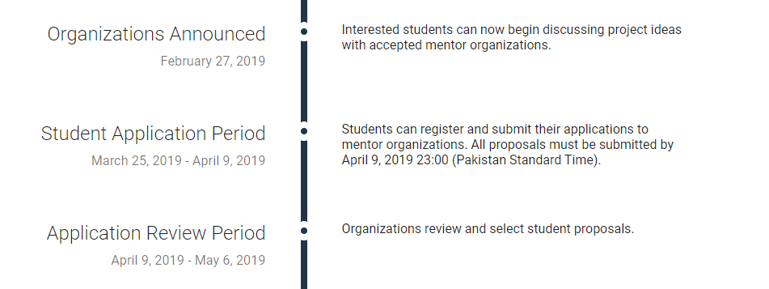
Timeline

Slide 9
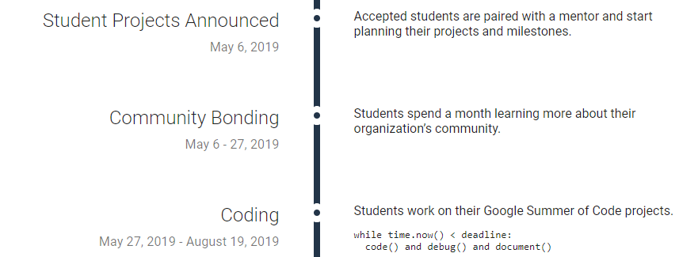
Timeline

Slide 10
Application Procedure
Choose your project and organization (upto 3)
Contribute to organization (fix typos, minor bugs, add features)
Write proposal for chosen project
Get proposal reviewed by mentors
Submit proposal, proof of enrollment

Slide 11


My Journey
NOOR BINTE AMIR

Slide 12

First Stop
QUORA
Go through procedure, perks and experiences of past students

Slide 13

Second Stop
MEDIUM
Learn from experiences of past students and copy them

Slide 14
Third: Getting Started
GSOC SITE
summerofcode.withgoogle.com
Review timeline
Read student guides and FAQ
Shortlist organizations and projects

Slide 15
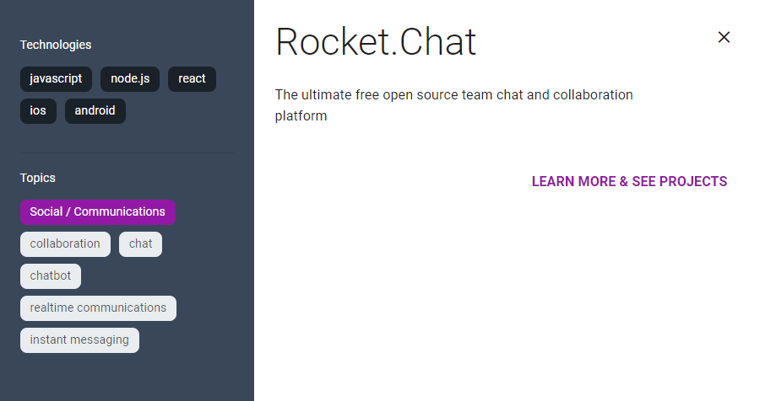

Slide 16
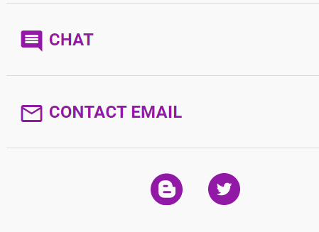
Fourth
MAKING CONTACT
Scout all contact options
Email mentors to show interest asap
Ask for advice and tips
Show enthusiasm
Find chat forums

Slide 17
Fifth
ANALYZE
Shortlist active organizations
Determine competition
Number of gsoc students interested
Read chats
Check number of contributing students on github
Ask mentor how you can one up the competition
Download and Install softwares

Slide 18
Sixth
WRITING PROPOSAL
Follow any given guidelines
Focus on presentation
Refer to proposals by past selected students

Slide 19
Writing Proposal
DEMO

Slide 20
WRITING PROPOSAL
Highlight strengths you have
Talk about your projects that solve problems
Present them well on github with screenshots
Well defined timeline
Support with code and diagrams
Show enthusiasm!

Slide 21
Get your proposal reviewed!

Slide 22

Final Step
GITHUB
Fix typos, bugs and add features

Slide 23
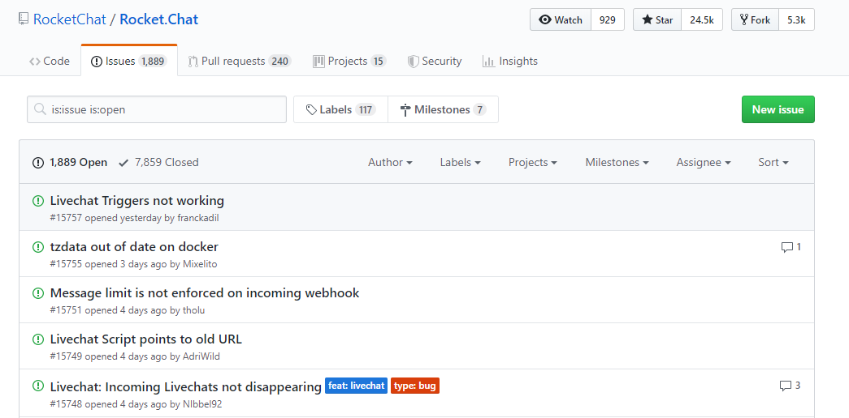

Slide 24
Keep in touch with your mentor!

Slide 25
Stay active during application review period!

Slide 26

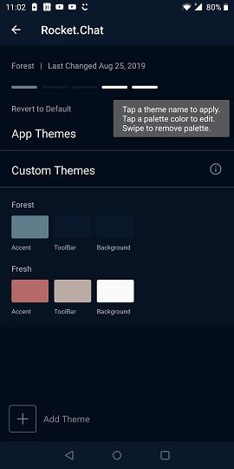
My Internship Experience
Helpful mentors
Confidence in working on collaborative projects
Improved approach towards writing code
Comprehensive skill development

Slide 27
Outcomes and Opportunities
Mentorship Opportunity
STIPEND
Cool Google T-shirt
Further opportunities like WTM
Job and internship preference
Speaking at notable events like DevFest
collaborations

Slide 28
Thank You!
Noor Binte Amir
GSoC Scholar 2019 WTM Scholar 2019

Slide 29
What is GSoC
Contribute to Free and Opensource Software
=> GSoC as Open => GSoC as Inclusive => GSoC as Opportunity

Slide 30
What is Opensource
It is a philosophy, or methodology that promotes free redistribution and access to a product’s design or ideas and implementation details. -> Open as in free -> Open as in access -> Open as in use and reuse -> Open as in distribute and redistribute

Slide 31
What is Opensource
-> The freedom to use the software and have access to the source code. -> The freedom to modify the software. -> The freedom to redistribute the software. -> The freedom to ensure that all modifications must be redistributable.

Slide 32
My journey
-> GSoC 2013 (Failure) -> GSoC 2014 (Rejected) -> GSoC 2015 (Accepted ☺) -> GSoC 2016 (Shortlisted by two organizations and accepted☺)

Slide 33
Questions
1. What is Google Summer of Code? 2. What is an Organization in GSoC? 3. What is an Umbrella Organization? 4. What is a Project? 5. What is a Project Idea? 6. What is a Project Proposal? 7. Who are the Mentors? 8. Who are the Organization Administrators? 9. How to Participate? 10. How to select an organization?

Slide 34
Questions
11. How to connect to an organization? 12. How to communicate to a mentor? 13. How to collaborate with the community? 14. Which idea you can propose? 15. Which skills are needed? 16. How to write a proposal? 17. When to start working? 18. What is the role of GitHub profile? 19. What is the role of LinkedIn profile? 20. What are the perks of GSoC student?

Slide 35
Qualities of GSoC Aspirer
• Logic over Syntax • Understanding of Code • Reading of Documentation • Fast Learners and Quick Adopter • Independent Thinkers and Team Players • Comfortable with Linux Environment • Good Foundation of Data Structures and Algorithms • Used to with Distributed Version Control System E.g. Git (GitHub) • Confidence, Communication, Collaboration and Contribution

Slide 36
Thank You! Contact: +92-312-5518018 tahirramzan@alumni.vu.edu.pk https://github.com/tahirramzan https://www.linkedin.com/in/tahirramzan/ https://web.facebook.com/tahirRamzanOne

